Slide 1
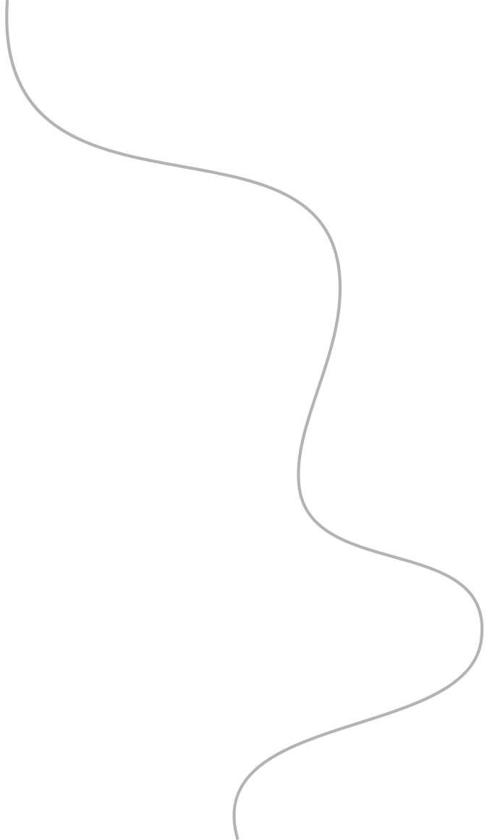
Problem
01
02
03
Sparse Structure in Spatial Data:
How can sparsity be incorporated into the modeling of spatial data?
Basis Graphical Lasso Method:
How does the Basis Graphical Lasso method work in the context of modeling spatial data?
What advantages does the Basis Graphical Lasso offer over other methods in capturing the underlying structure of spatial data?
Modeling Nonstationarity:
How can nonstationarity be effectively modeled in spatial data?

Slide 2
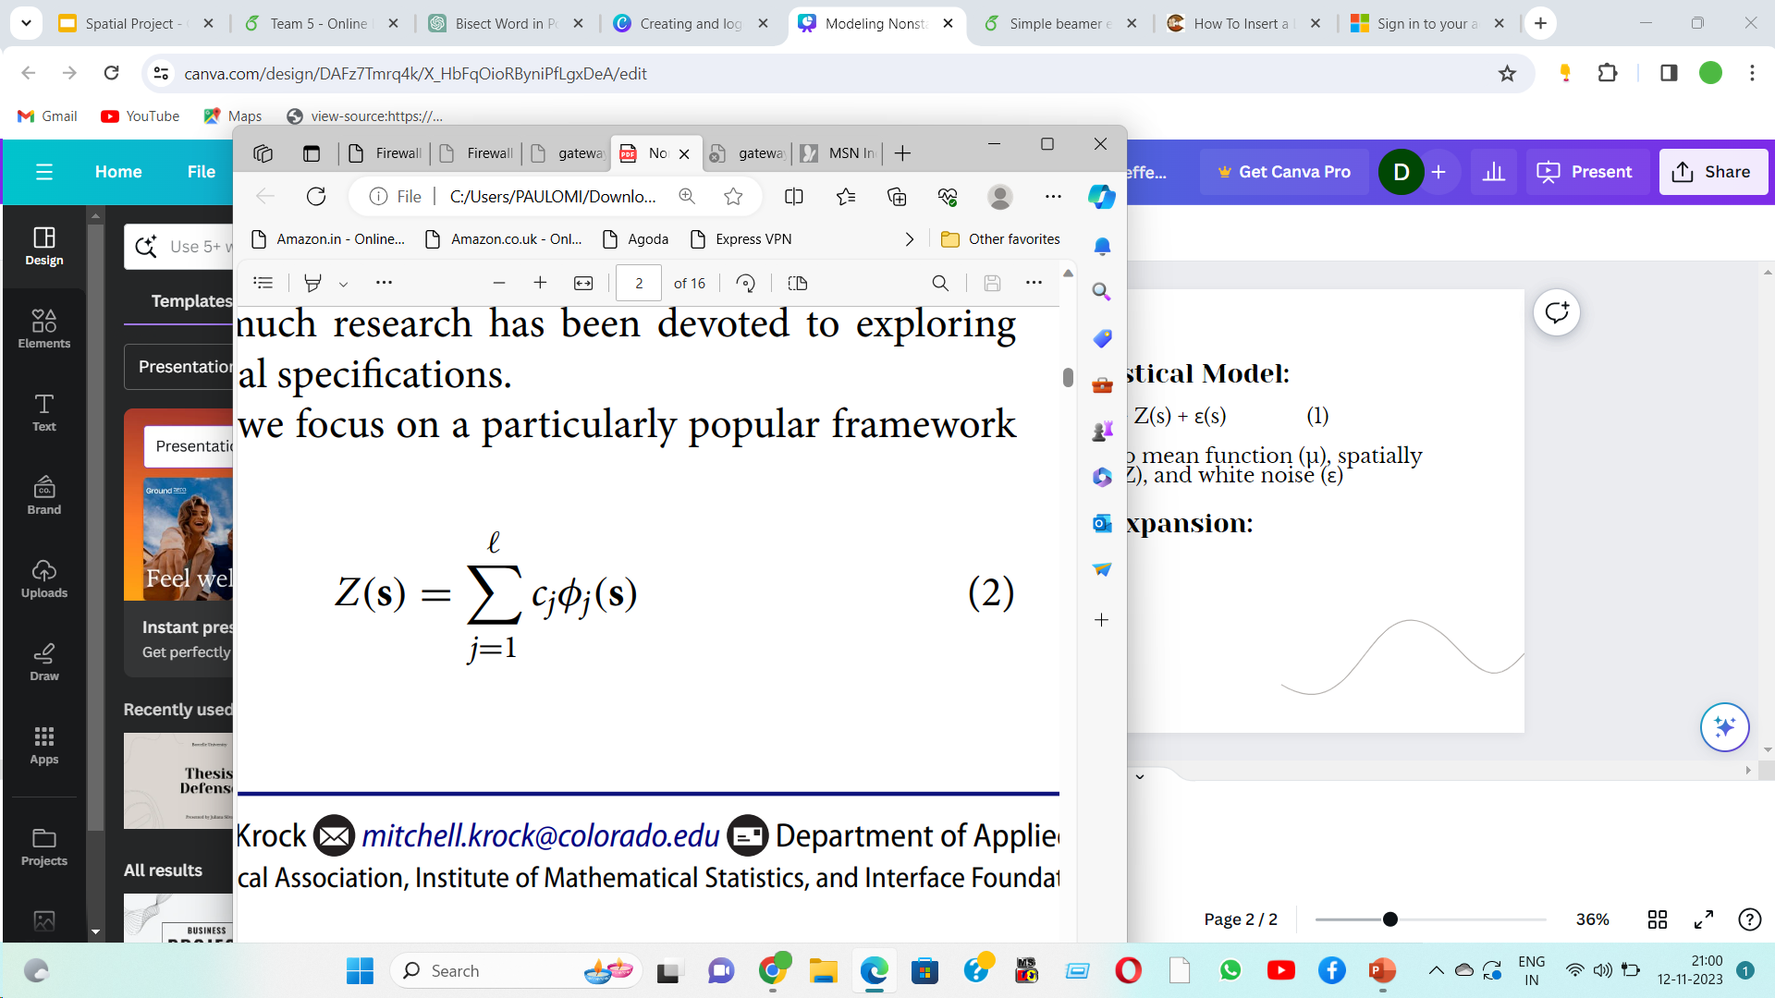
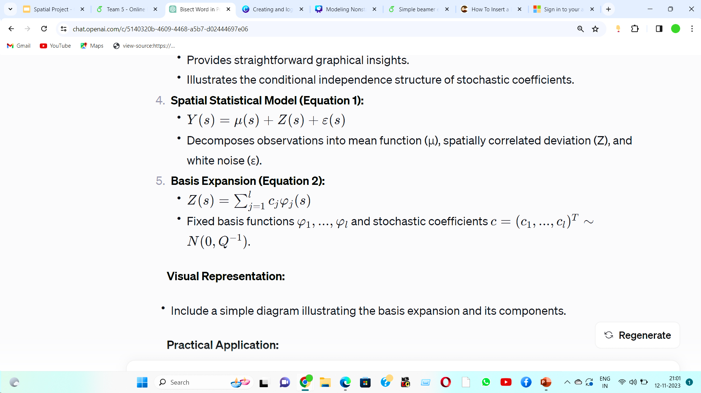
Spatial Statistical Model:
Y(s) = μ(s) + Z(s) + ε(s) (1)
Decomposes observations into mean function (μ), spatially correlated deviation (Z), and white noise (ε)
Basis Expansion:

Slide 3

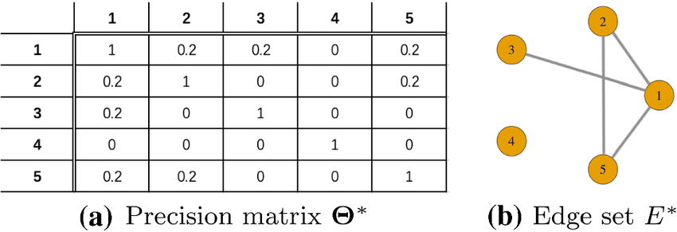
Introduction
Relax modeling assumptions on stochastic coefficients c (or equivalently Q).
Approach:
Shift from specific assumptions to a Gaussian graphical model.
Focus on the zero/nonzero pattern in the precision matrix Q.
Graphical Structure:
Exploit equivalence between Gaussian graph structures and precision matrix patterns (Rue and Held 2005).
Multivariate Gaussian graph structure represents the zero/nonzero pattern in Q.
Distinctive Aspect:
Do not specify the graph structure explicitly.
Aim to infer edges by estimating entries in Q.

Slide 4
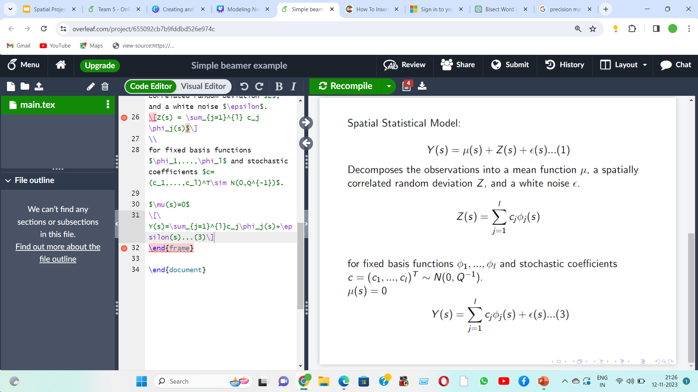
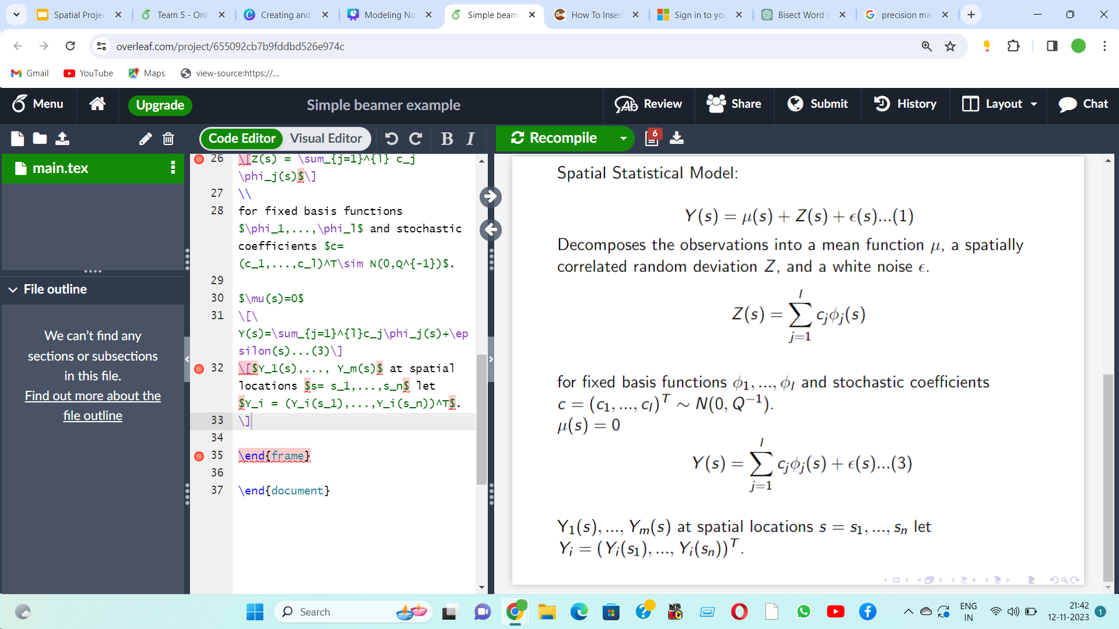
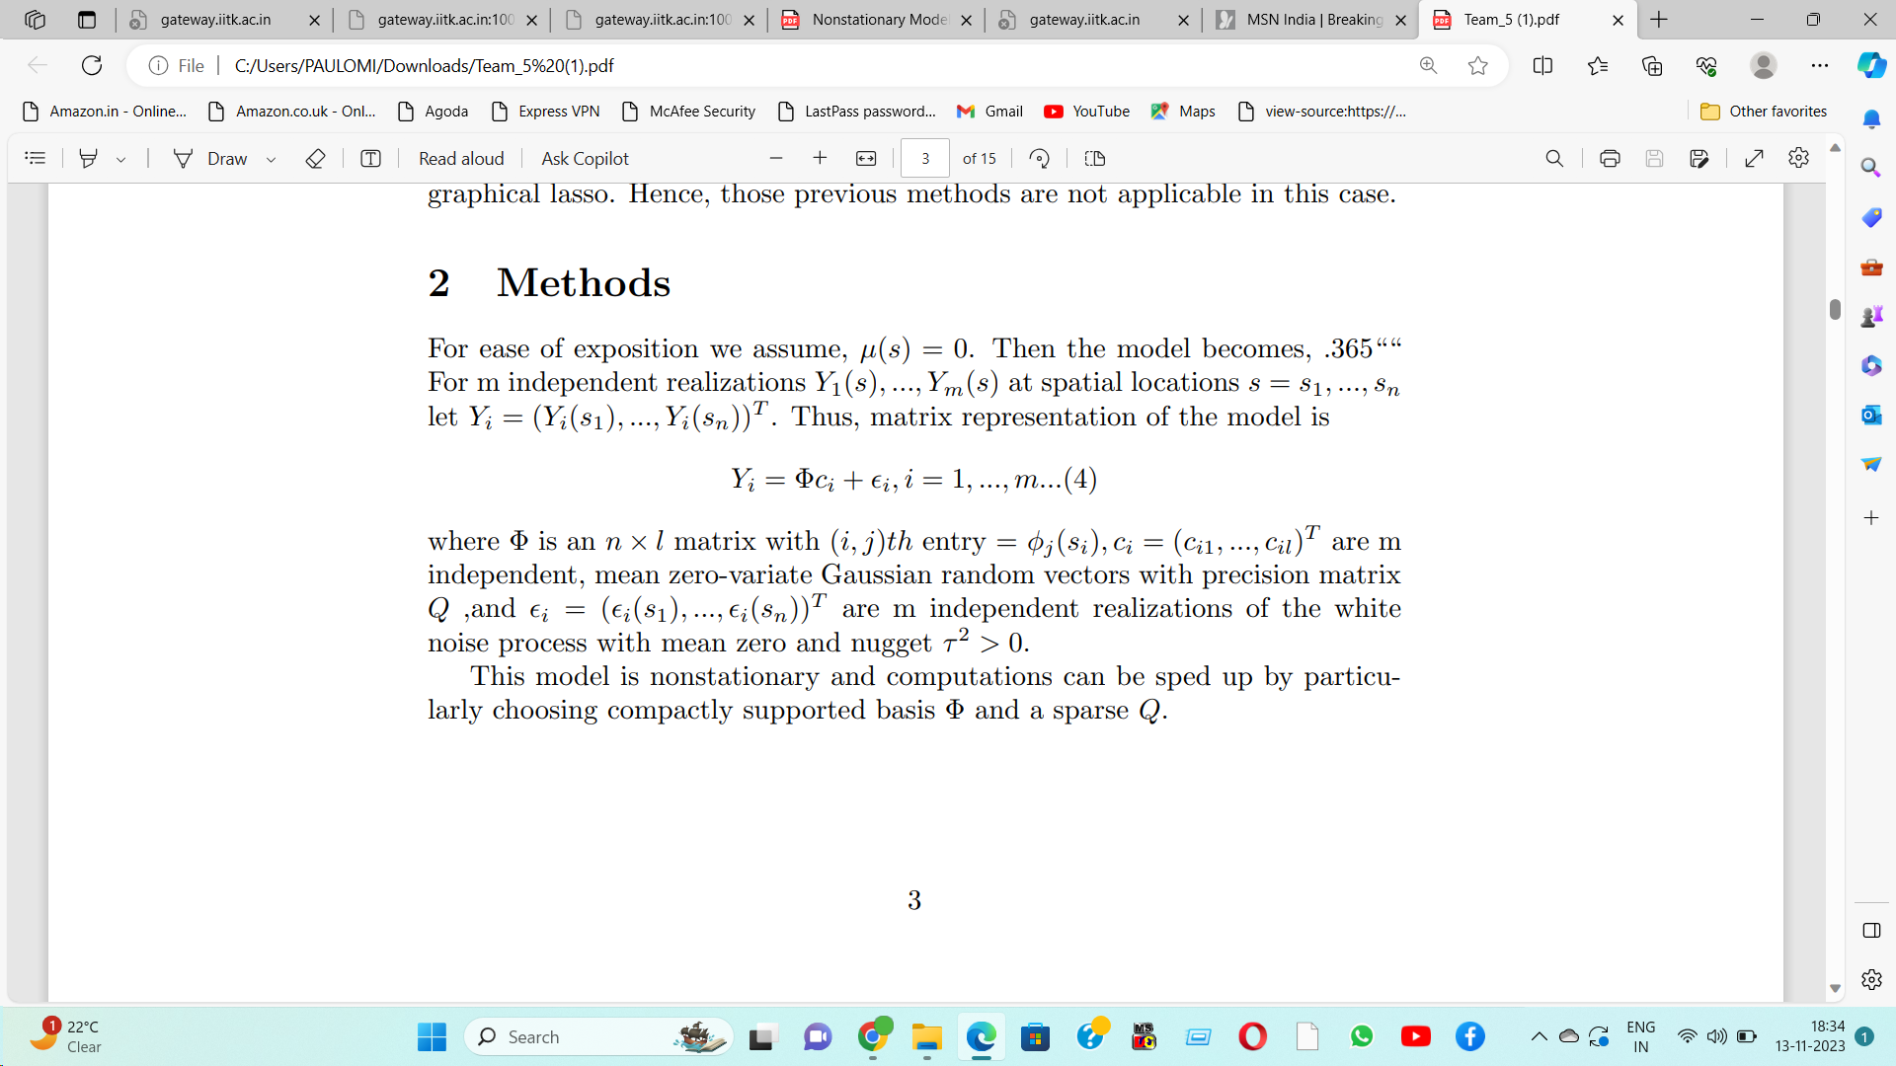
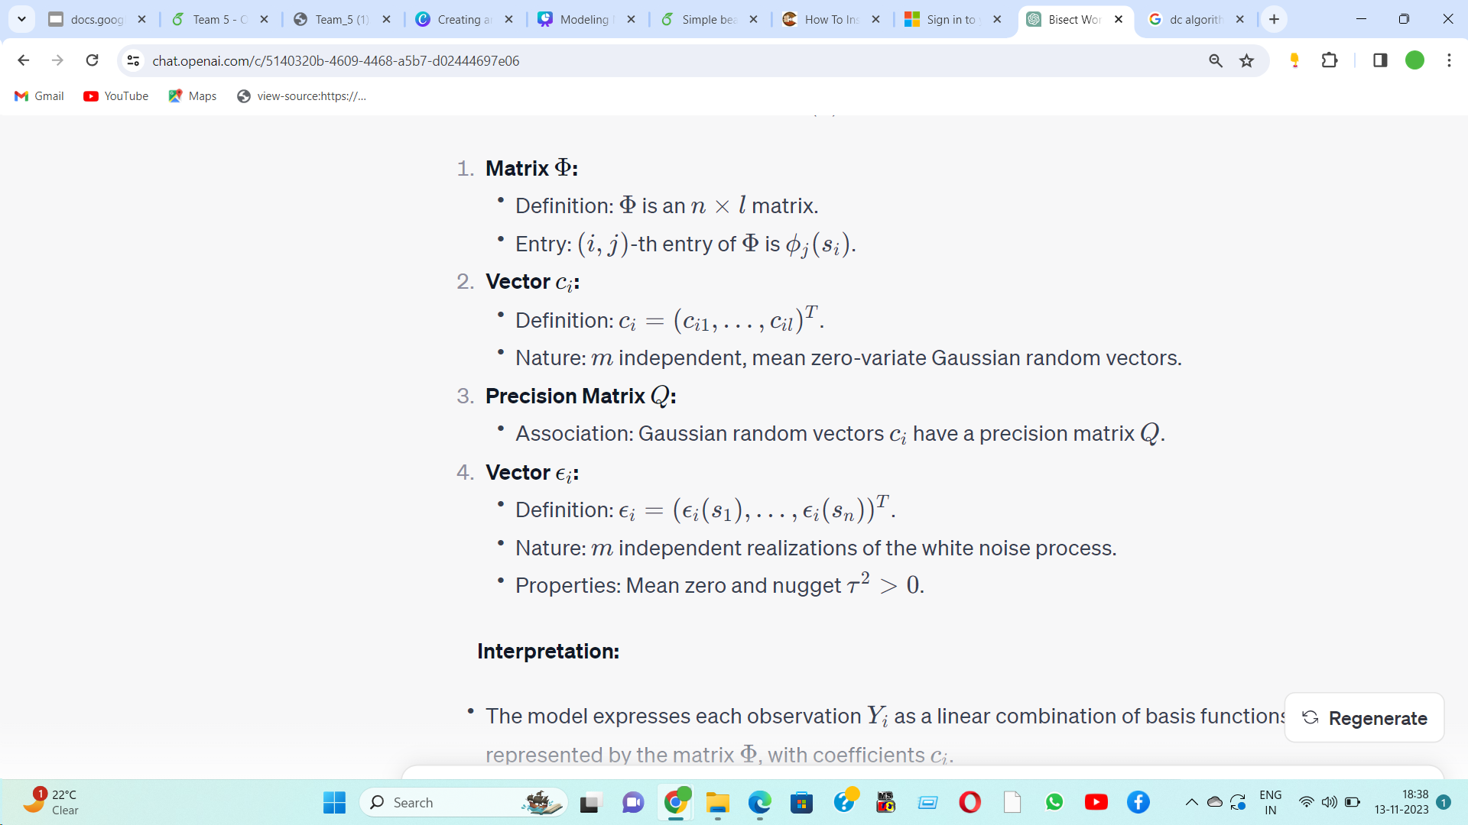
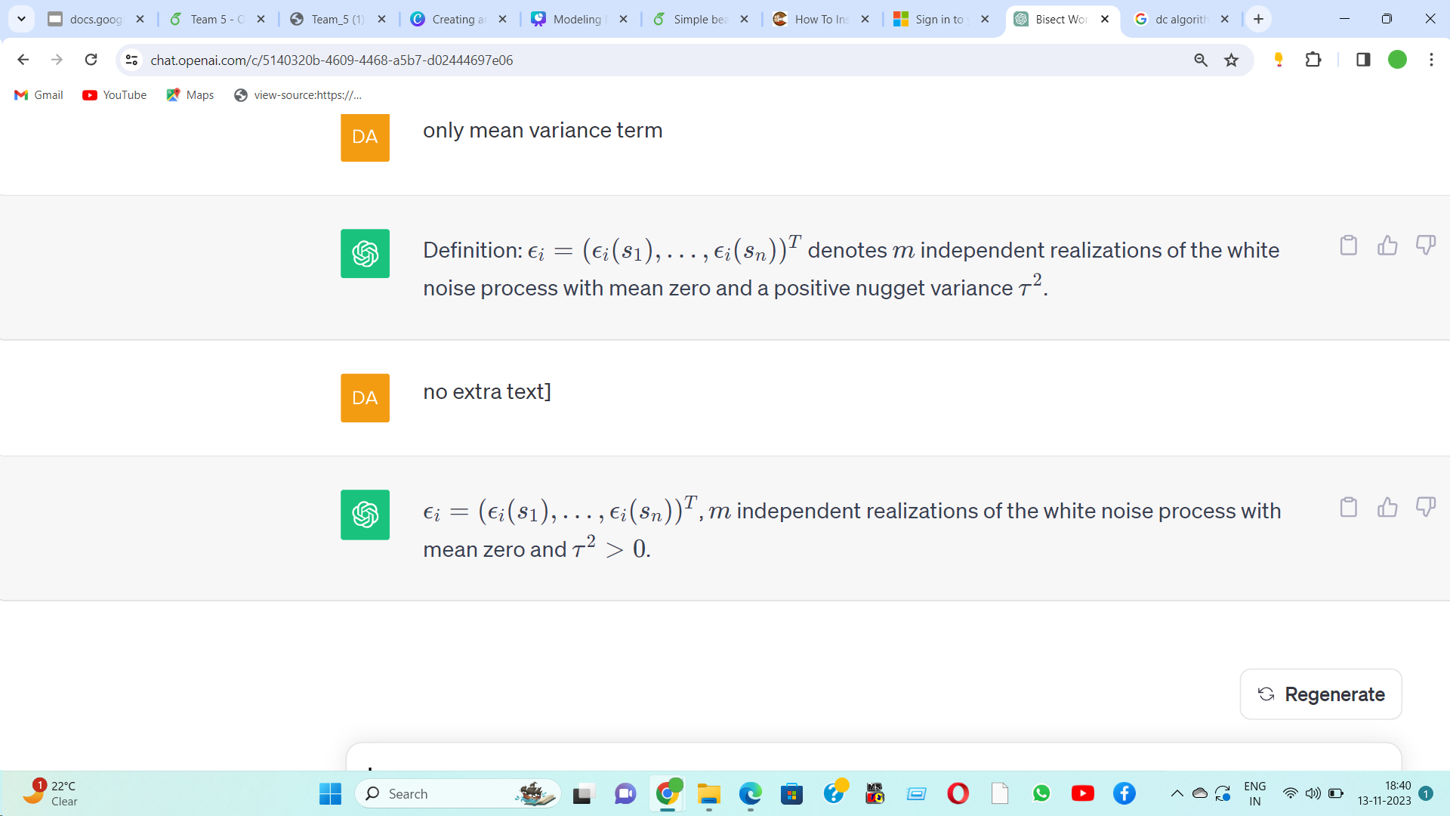
Methods
For simplicity, assume that μ(s) = 0 in equation (1)
The observational model is given by
For m independent realizations
Thus, matrix representation of the model is

Slide 5

Basis Graphical Lasso
Basis Graphical Lasso is a statistical modeling approach that incorporates a basis to represent relationships between variables in a graphical model. It employs an Lasso penalty to induce sparsity, supporting the notion that the response at any location is connected to its neighboring locations. This approach selects the most relevant spatial dependecies while pushing less significant dependencies to zero.

Slide 6
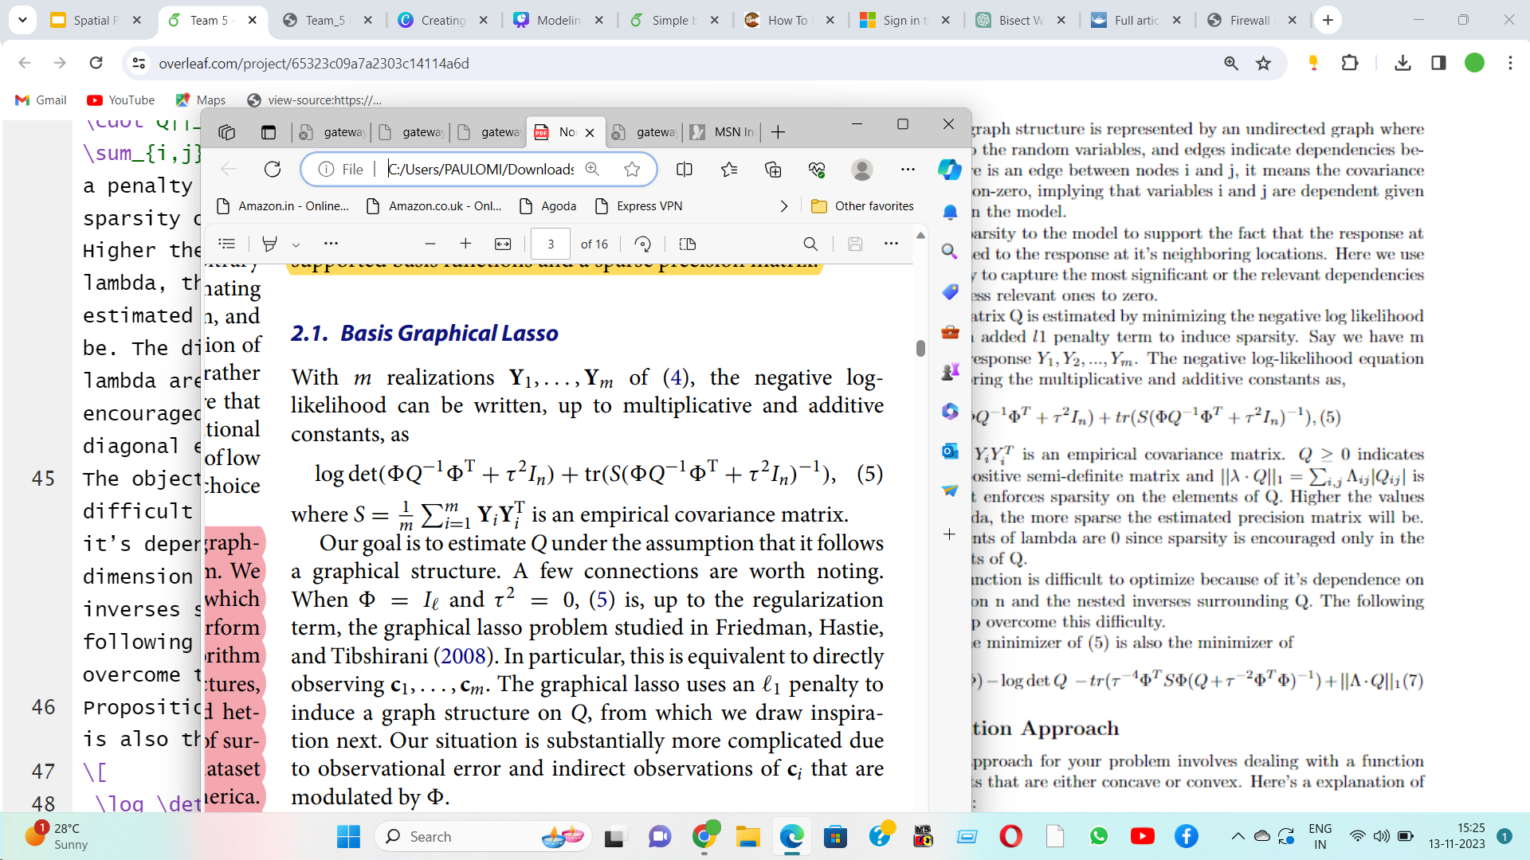
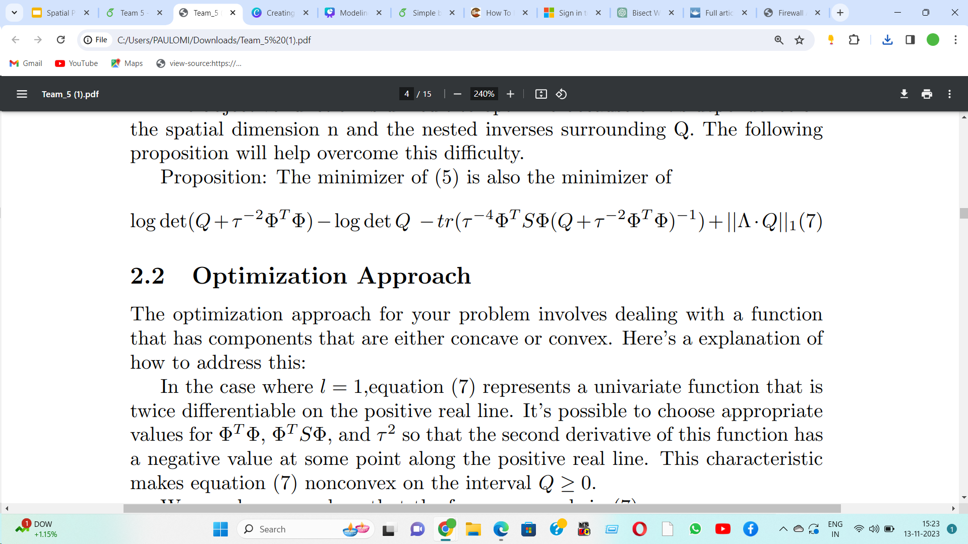
Estimation Process:
Negative Log Likelihood:
Q is estimated by minimizing the negative log likelihood of the data with an added L1 penalty term to induce sparsity.
(6)

Slide 7
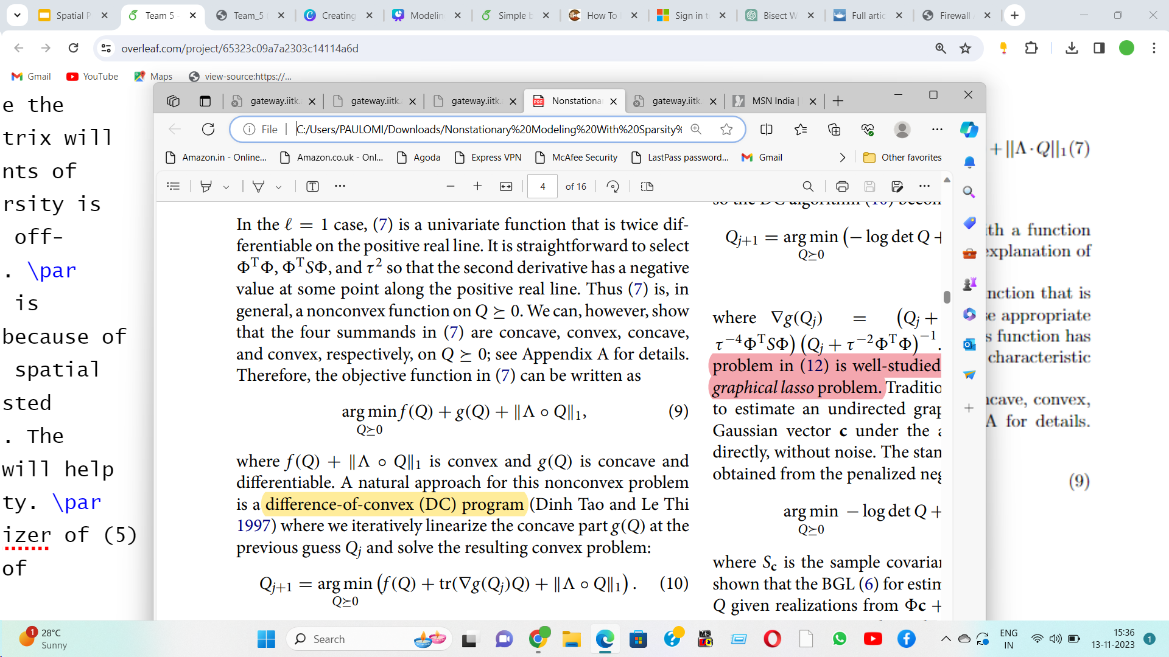
Optimization Approach
Concave
Convex
Concave
Convex
To address this nonconvex problem is a Difference-of-Convex (DC) program

Slide 8
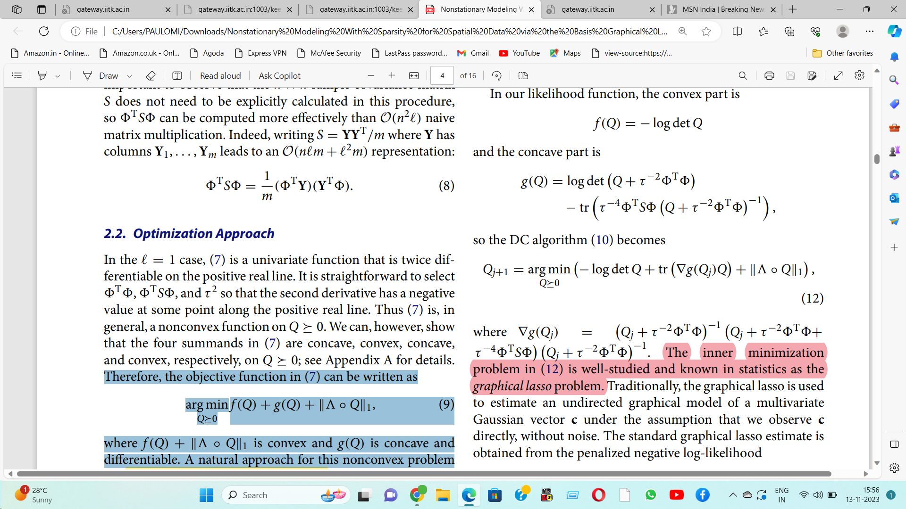
DC Algorithm:
In DC algorithm, the majorization-minimization is applied to solve a series of convex subproblems.
DC Algorithm Equation:
Inner minimization problem in (12) is well-studied and known in statistics as the graphical lasso problem

Slide 9

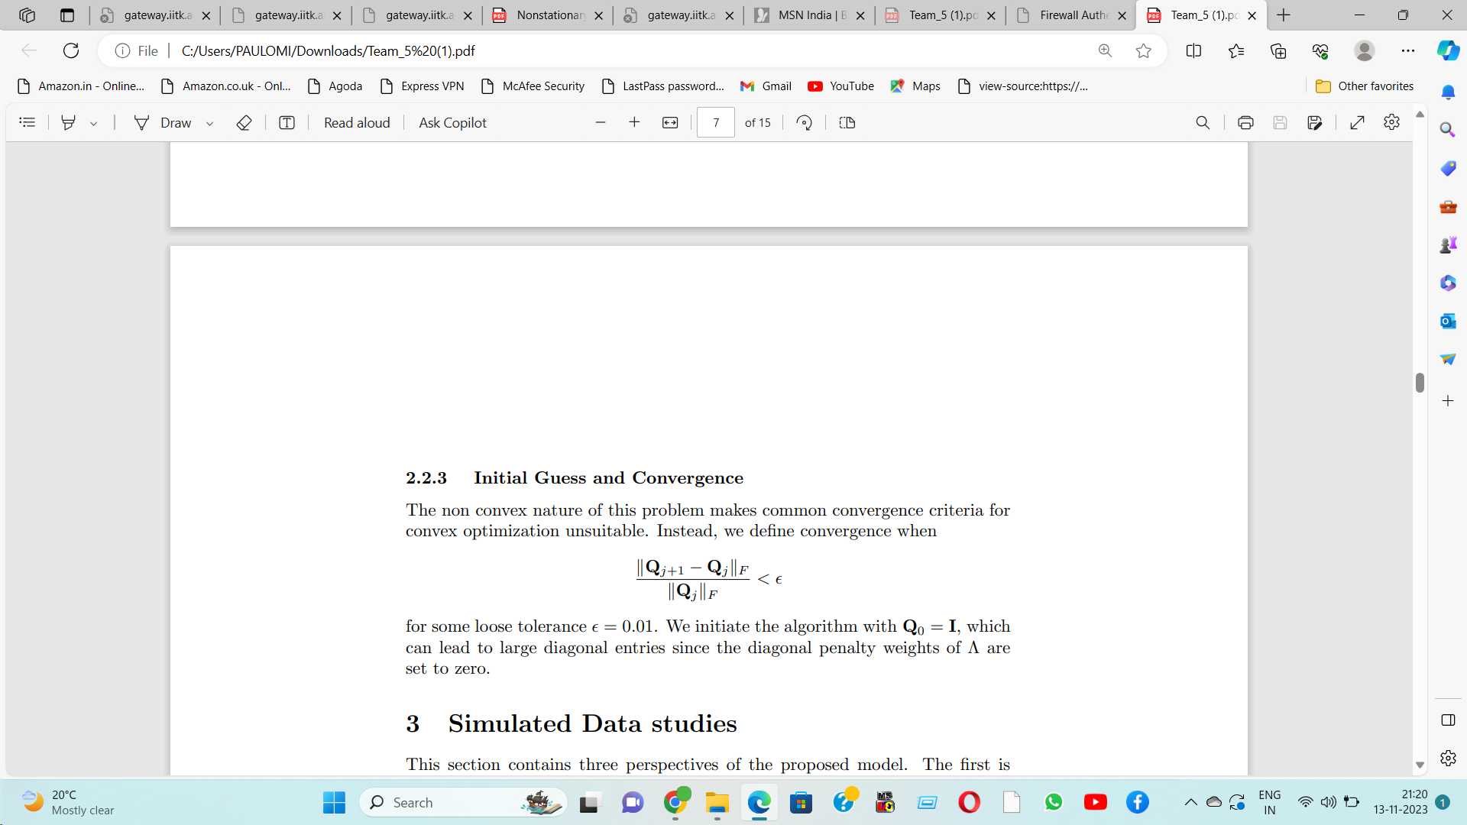
Estimating the Nugget Variance
L-BFGS
optimization routine using the ‘optim‘ function in R.
Estimating the Penalty Weight
Convergence is defined in the non-convex optimization by Frobenius norm criteria:

Slide 10
Simulation Study
Regression Method
Following the notation in (4), the stochastic coefficient vector ˆc, is estimated using the method of least squares as (ΦT Φ)−1ΦT Yi, where (ΦT Φ)−1ΦT is the projection matrix and Yi is the response vector.
FRK approach
Another possible approach in the style of fixed rank kriging is to retrieve K = Q−1 by minimizing the loss function
BGL Method
If Φ is not full rank, we cannot consider this least squares projection - a ridge regression maybe more suitable, for example. Once ˆc is created, its sample covariance S is substituted into the graphical lasso; we call this approach the regression method.
Argmin K0 KT + τ 2In − SF (16) as proposed by Cressie and Johannesson. the optimal parameter
estimate is ˆK = R−1QT(S−τ 2In)Q(R−1)T where = QR is the
QR decomposition of . Again, if is not full rank, we cannot
consider this method.

Slide 11
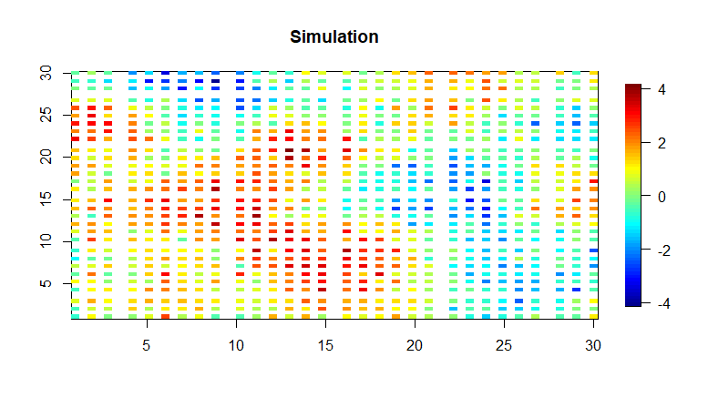
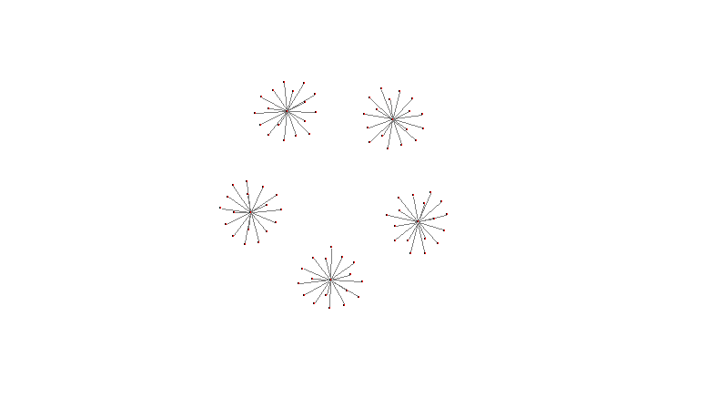
Displaying the graphical structure for Q and a realization from the basis model.

Slide 12
Setup of the Study:
Spatial domain: unit square [0, 1]×[0, 1]
Basis functions: Compactly supported Wendland bases from the LatticeKrig R package.
Number of locations: n = 2500 Noise-to-signal ratio: 0.1
Penalty matrix: It is populated with 0.2 and zeros on the diagonal.
Initial guess: is the identity matrix Q₀ = I.
*We stop the BGL at a relative error of 0.01.
Statistic | m | Loss/FRK | Regression | BGL
Frobenius error | 1 | 8267 | 2.38 | 12.76
 | 5 | 156.04 | 1.11 | 1.32
 | 10 | 98.52 | 0.71 | 0.80
 | 20 | 49.84 | 0.47 | 0.78
 | 50 | 21.69 | 0.51 | 0.79
Observation:
The estimates based on minimizing the loss function (16) were poorly behaved in comparison to the BGL method, and the versions which did not directly call the FRK package produced singular matrices.
The BGL method is more or less comparable to the regression-based idea.

Slide 13
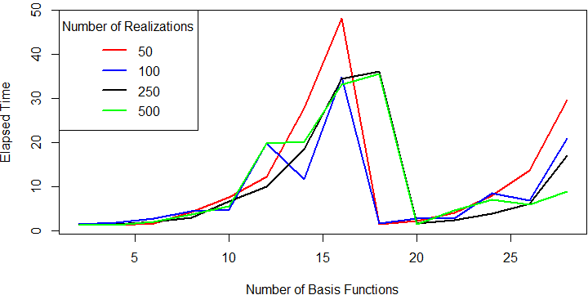
Timing Study
Setup of the Study:
Spatial domain: unit square [0, 1]×[0, 1]
Basis functions: Compactly supported Wendland bases from the LatticeKrig R package.
Number of locations: n = 2500
Noise-to-signal ratio: 0.1
Penalty matrix: It is populated with 0.2 and zeros on the diagonal.
Initial guess: is the identity matrix Q₀ = I.
*We stop the BGL at a relative error of 0.01.
In Figure, we display the elapsed time for the BGL
Here, we see that having multiple realizations helps reduce computation time due to a more stable estimate of the sample spatial covariance matrix S.

Slide 14
Recovering unknown precision structure using local basis functions
Consider a localized problem where a basis of compactly supported functions was used on a grid using the LatticeKrig model setup which we briefly describe here: basis functions are compactly supported Wendland functions whose range of support is set so that each function overlaps with 2.5 other basis functions along axial directions.
The model basis functions will correspond to either a single level or multiresolution model. The precision matrix Q is set to a stationary spatial autoregressive structure.
Setup of the Study:
Spatial domain: unit square [0, 1]×[0, 1]
Basis functions: Compactly supported Wendland bases from the LatticeKrig R package.
Number of locations: n = 2500 Noise-to-signal ratio: 0.1
Penalty matrix: It is populated with 0.2 and zeros on the diagonal.
Initial guess: is the identity matrix Q₀ = I.
*We stop the BGL at a relative error of 0.01.

Slide 15
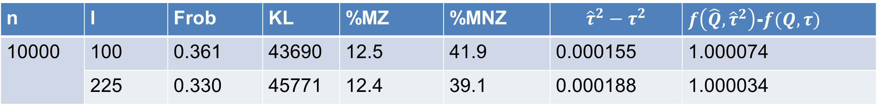
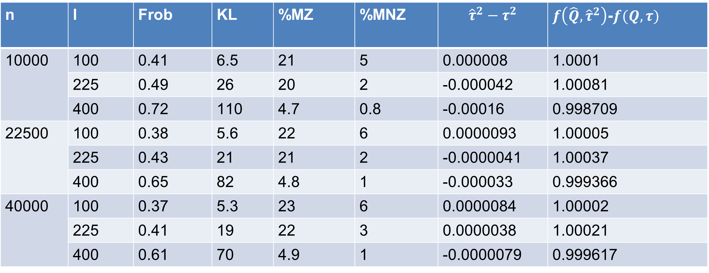
Simulation study results for the single level case.
n | l | Frob | KL | %MZ | %MNZ | $${\hat{τ}}^{2}−τ^{2}$$ | $f\left(\hat{Q}, {\hat{τ}}^{2}\right)$-$f(Q, τ)$
10000 | 100 | 0.41 | 6.5 | 21 | 5 | 0.000008 | 1.0001
 | 225 | 0.49 | 26 | 20 | 2 | -0.000042 | 1.00081
 | 400 | 0.72 | 110 | 4.7 | 0.8 | -0.00016 | 0.998709
22500 | 100 | 0.38 | 5.6 | 22 | 6 | 0.0000093 | 1.00005
 | 225 | 0.43 | 21 | 21 | 2 | -0.0000041 | 1.00037
 | 400 | 0.65 | 82 | 4.8 | 1 | -0.000033 | 0.999366
40000 | 100 | 0.37 | 5.3 | 23 | 6 | 0.0000084 | 1.00002
 | 225 | 0.41 | 19 | 22 | 3 | 0.0000038 | 1.00021
 | 400 | 0.61 | 70 | 4.9 | 1 | -0.0000079 | 0.999617
NOTE: Scores are averaged over 30 independent trials. Each column represents the number of observation samples, number of basis functions, Frobenius norm, KL divergence, percent of true zeros missed, percent of true nonzeros missed, estimated nugget minus true nugget, and the estimated negative log-likelihood divided by the true negative log-likelihood.
Measures simulated from our code.
n | l | Frob | KL | %MZ | %MNZ | $${\hat{τ}}^{2}−τ^{2}$$ | $f\left(\hat{Q}, {\hat{τ}}^{2}\right)$-$f(Q, τ)$
10000 | 100 | 0.361 | 43690 | 12.5 | 41.9 | 0.000155 | 1.000074
 | 225 | 0.330 | 45771 | 12.4 | 39.1 | 0.000188 | 1.000034

